Slide 1
Optimizing UAV Resource Allocation: Strategies for Dynamic Prioritization and Modular Route Management
Presented By:
Akash Mishra
Sunny Kumar
Biranjay Kumar Gupta
Presented To:
Tarun Bishwas

Slide 2
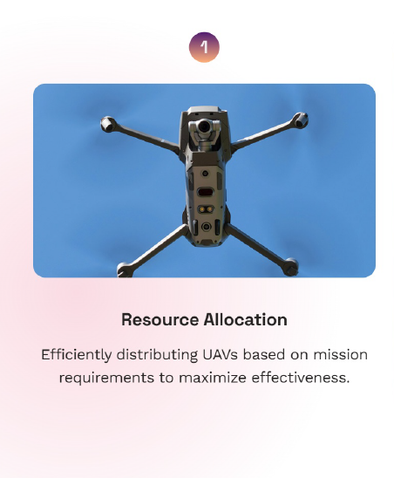
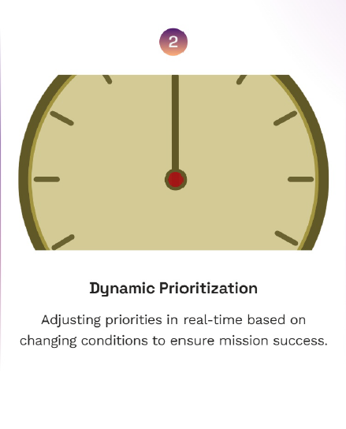
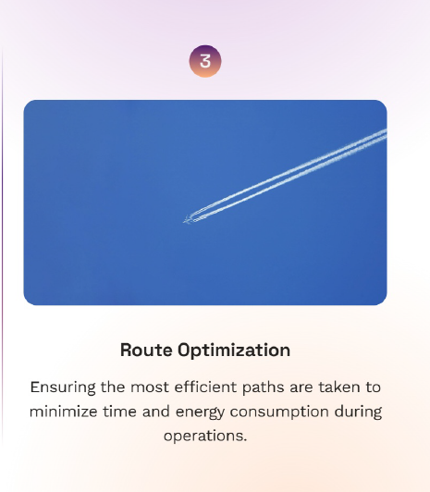
Introduction to UAV Resource Allocation
In today’s rapidly evolving landscape, Unmanned Aerial Vehicles (UAVs) are becoming vital for various applications. This presentation explores strategies for optimizing resource allocation through dynamic prioritization and modular route management, enhancing efficiency and effectiveness in UAV operations.

Slide 3

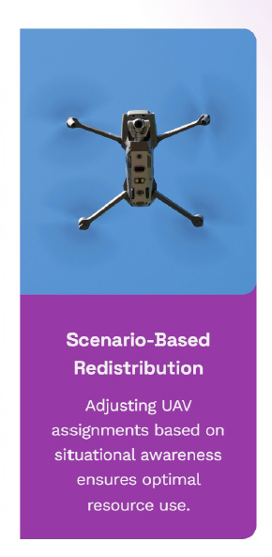

Understanding UAV Resource Allocation
UAV resource allocation involves distributing limited resources such as time, fuel, and payload to achieve mission objectives. Effective allocation is crucial for maximizing operational efficiency and ensuring that UAVs can adapt to changing conditions in real-time.

Slide 4
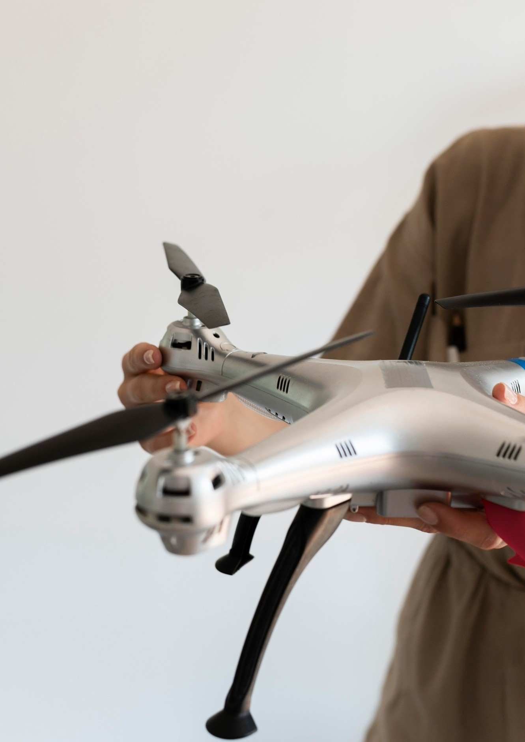
Dynamic prioritization refers to the ability to adjust task priorities based on real-time data and situational changes. This approach allows UAVs to respond to emergency requests or urgent tasks, ensuring that critical missions are completed promptly.

Slide 5

Modular route management involves breaking down missions into smaller, manageable segments. By utilizing modular routes, UAVs can optimize their paths, minimize travel time, and adapt quickly to unforeseen obstacles or changes in mission requirements.

Slide 6
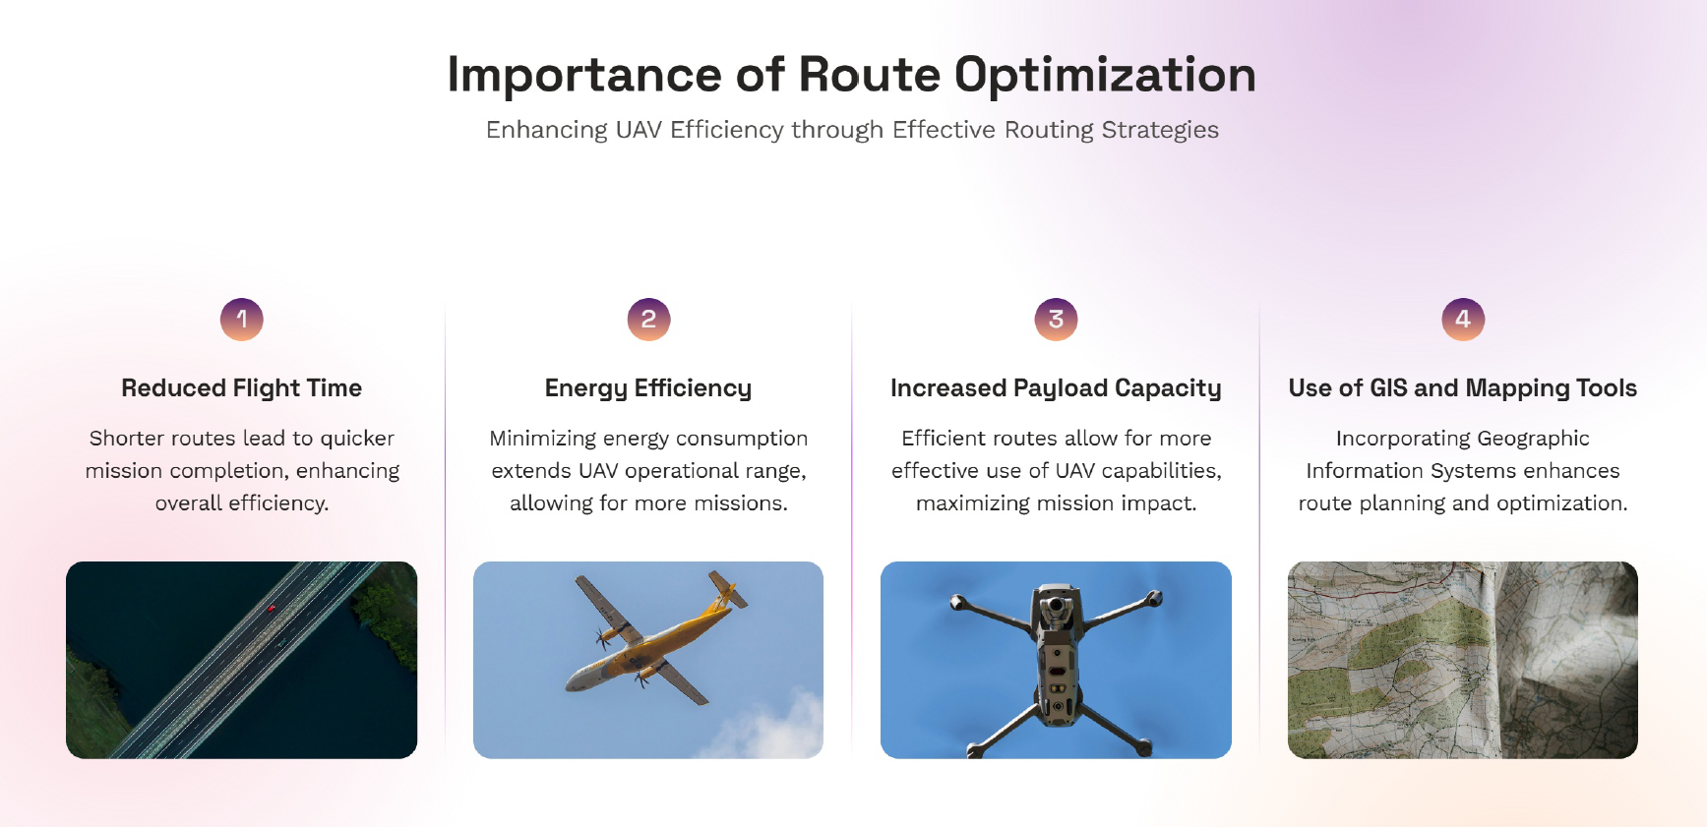

Slide 7
Key Challenges in Resource Allocation
Several challenges exist in UAV resource allocation, including limited battery life, unpredictable weather conditions, and communication delays. Addressing these challenges is essential for developing robust allocation strategies that ensure mission success.

Slide 8


Leveraging real-time data analytics is crucial for effective UAV resource allocation. By analyzing data from various sources, UAVs can make informed decisions that enhance operational effectiveness and adapt to changing environments.

Slide 9
Algorithmic Approaches
Utilizing advanced algorithms for resource allocation can signiﬁcantly improve decision- making processes. Techniques such as genetic algorithms and machine learning can help optimize routes and prioritize tasks based on historical data and predictive modeling.

Slide 10

Before deployment, it is essential to conduct simulations and testing of resource allocation strategies. This process allows for the identiﬁcation of potential issues and the reﬁnement of approaches, ensuring that UAVs operate at peak efficiency in real- world scenarios.

Slide 11

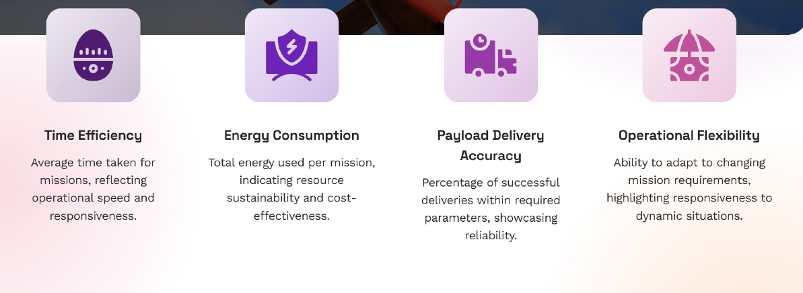
Examining real-world case studies provides valuable insights into successful UAV resource allocation strategies. These examples highlight how organizations have implemented dynamic prioritization and modular route management to enhance operational outcomes.

Slide 12

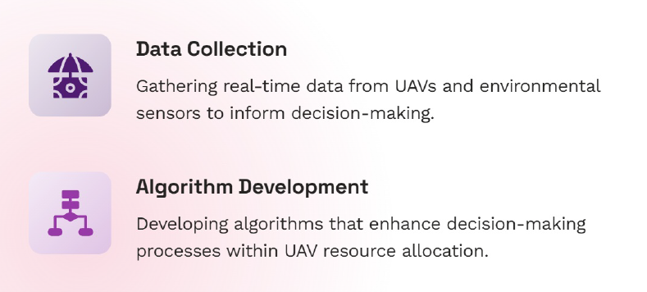
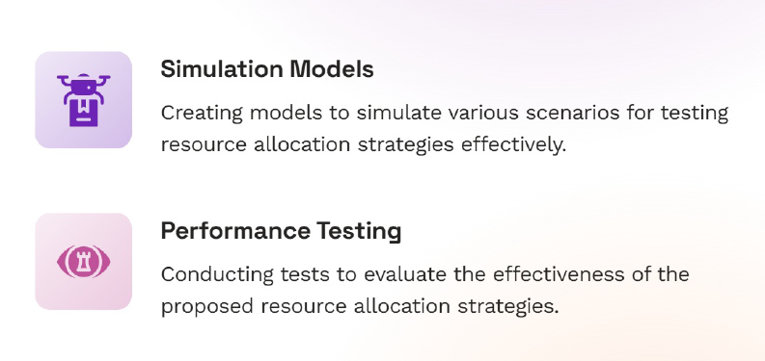
To optimize UAV resource allocation, organizations should adopt best practices such as continuous training, investing in cutting-edge technology, and fostering a culture of innovation. These practices will ensure sustainable and effective UAV operations.

Slide 13
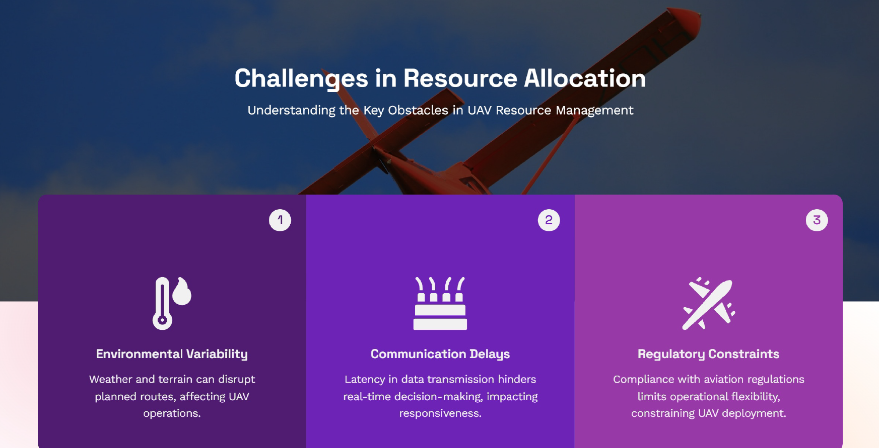

Slide 14
The future of UAV resource allocation is promising, with advancements in AI, machine learning, and improved sensor technologies. These innovations will further enhance the ability to prioritize tasks dynamically and manage routes effectively.

Slide 15
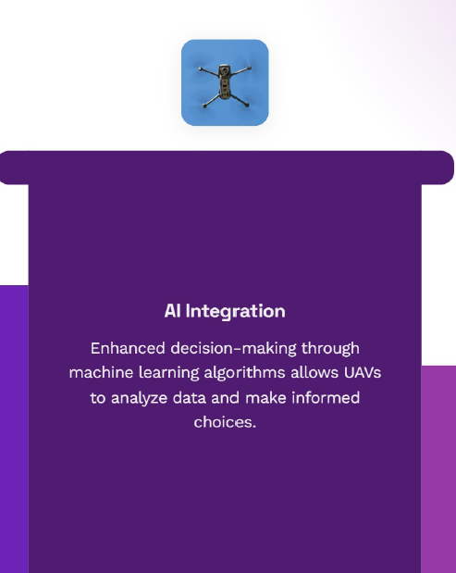
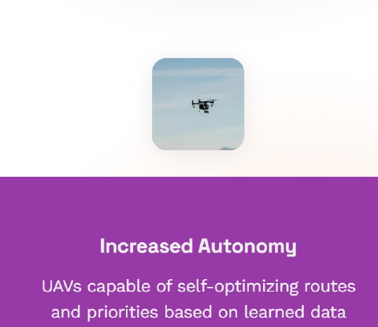
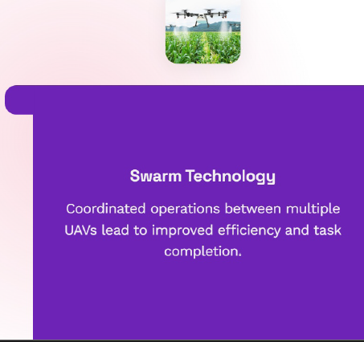
In conclusion, optimizing UAV resource allocation through dynamic prioritization and modular route management is essential for maximizing operational efficiency. As technology continues to evolve, the potential for UAVs in various applications will only grow, paving the way for innovative solutions.

Slide 16
